Slide 1
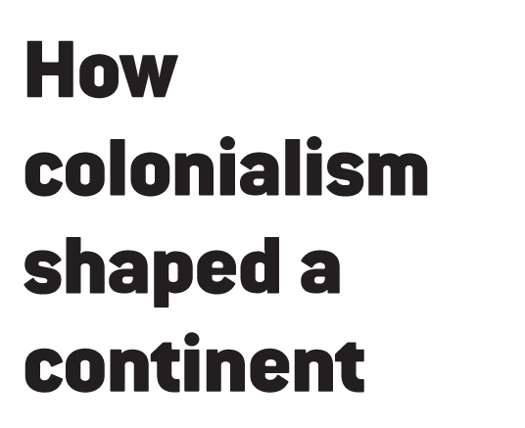

Slide 2
In our September 20, 2010, cover story, you’ll read about a historic anniversary. In one year—1960—17 African nations gained their independence.
For Africa, the era of colonialism—a foreign power controlling faraway territory—was drawing to a close. But its legacy is still felt today.
Read on to learn more about European colonialism in Africa.

Slide 3
• In 1482, Portuguese sailors landed at the mouth of the Congo River, in what is now the Democratic Republic of the Congo.
• They erected the fortress of São Jorge de Mina (pictured here). Trading with native people, they built an empire on items like spices and gold.
• The Portuguese also spread Roman Catholicism to some of the area’s people.

Slide 4
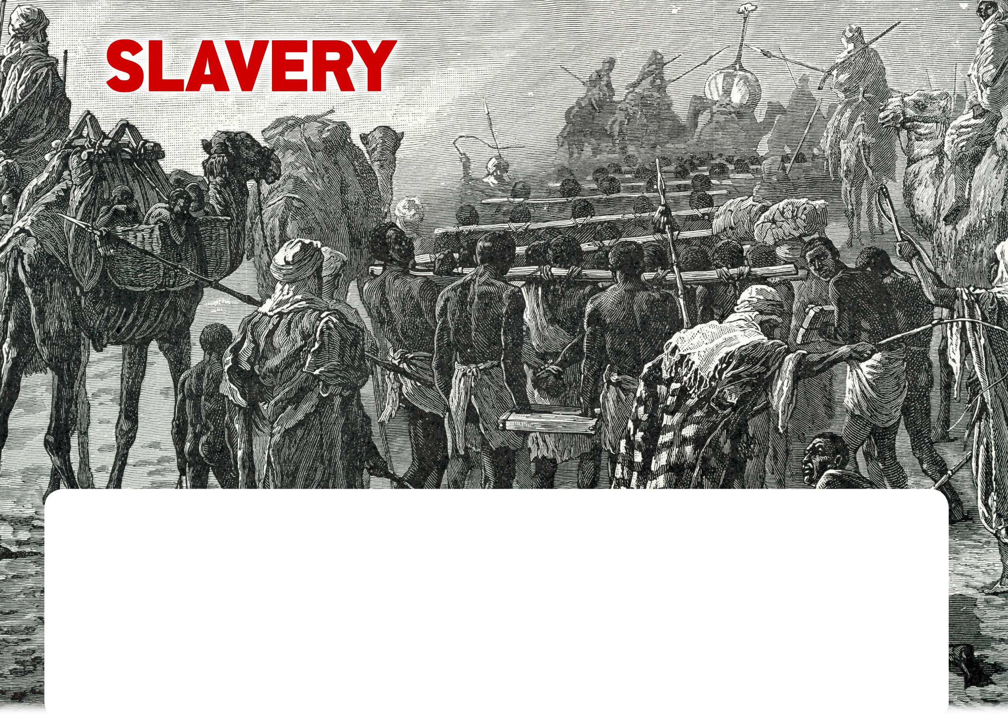
• Other Europeans soon arrived to exploit Africa’s valuable resources, including its people.
who would raid villages and kidnap other Africans to sell. The raiders often brought their slaves by caravans, like this one, to trading ports on Africa’s west coast.
• From the 15th to 19th centuries, an estimated 12 million Africans were sold into slavery. Most of them were taken to the Americas, including the United States.
• Europeans purchased slaves from West Africans

Slide 5
• One of the first Europeans to explore Africa’s interior was David Livingstone (right), a Scottish missionary. When he didn’t return from a journey in the late 1860s, search parties set out to find him.
• One group was led by British explorer Henry Morton Stanley (left). When he finally found the missionary in 1871, Stanley reportedly uttered the now-famous line: “Dr. Livingstone, I presume?”
• Livingstone’s explorations, like Stanley’s after him, were crucial in blazing a path for Europeans to seize—and exploit— the continent’s long-uncharted interior.

Slide 6
• Stanley explored the Congo River for King Léopold II of Belgium. Léopold seized a vast territory that became the Belgian Congo.
• Using enslaved Africans, Léopold made a fortune in rubber, diamonds, and other resources from the Congo. The King was said to have ordered his overseers to cut off the hands of unproductive workers.
• As many as 10 million Africans may have been killed during Léopold’s reign. This German cartoon reflects the belief that the King used severed heads to terrorize people.

Slide 7
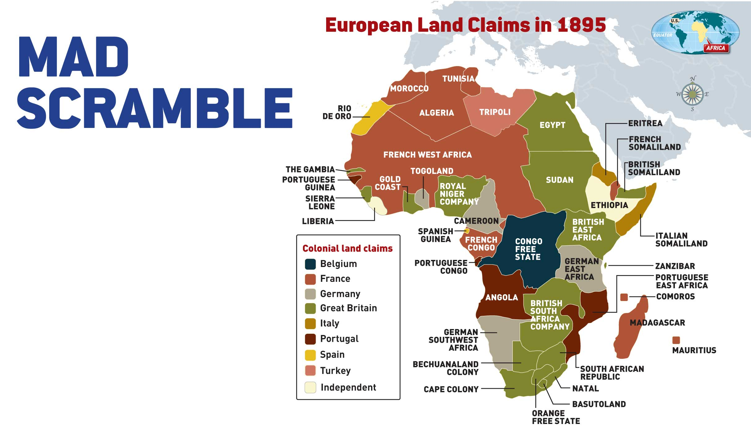
• By the mid-19th century, European powers were competing fiercely for the continent’s riches. Historians call this period the “scramble for Africa.”
• In 1884, European powers met in the German empire’s capital of Berlin. The meeting led to a map of Africa similar to this one. The borders ignored the fact that Africans were not one people but many.
• The Europeans merged some 10,000 distinct peoples—each with its own language and traditions—into
40 colonies. To this day, European-drawn borders contribute to the continent’s serious social and political problems.

Slide 8
• Few people believed in colonialism more passionately than Cecil Rhodes (1853-1902), a British businessman. He dreamed that white Britons would come to dominate Africa.
• Rhodes made a fortune in African diamonds. He was also Prime Minister of the Cape Colony (later South Africa) and founder of Rhodesia (today Zimbabwe).
• A man of mammoth ambition, Rhodes sought to expand British control further by running a railroad from Cape Town, in the Cape Colony, all the way to Cairo, in British-controlled Egypt, as this cartoon illustrates.

Slide 9
• Most Europeans in Africa did not gain or even expect great wealth. They moved there to farm the fertile soil, set up trading posts, or work as Christian missionaries.
• But Europeans amassed great wealth from the labor of poor black workers, such as the South African gold miners in this 1935 photo. Countless people died from the brutal conditions in gold and diamond mines.
• To keep control of Africa’s resources, European powers cracked down on independence movements in many countries.

Slide 10
• Independence movements began to take hold after World War II (1939-1945), as Europeans focused on rebuilding their own countries.
• This crowd in Lagos, Nigeria, celebrates the results of elections in 1959. Nigeria gained its independence from Britain the following year.
• The thrill of independence soon began to wane. In country after country, black leaders proved to be as corrupt and brutal as the former white colonizers. Resentments exploded into civil war in many countries.

Slide 11
• South Africa was a unique case. It had long been independent—but ruled by a white minority. In 1948, its government adopted a policy of apartheid (“apartness”).
• Apartheid divided South Africans by race. Whites, 14 percent of the population, had power over everyone else, including the 74 percent who were black.
• Years of global condemnation, fueled by protests in South Africa, led to apartheid’s end in 1991. In 1994, activist Nelson Mandela (pictured) became his country’s first black President.

Slide 12
1. What led European powers to divide and control the lands and peoples of Africa?
2. What advantages and disadvantages did colonial rule have
for Europeans? How does colonial rule still affect Africa?
3. “After climbing a great hill, one only finds that there are many
more hills to climb,” Nelson Mandela has said. How do his words
apply to Africa?

